Slide 1
Big Data Technologies
Project Presentation
Fraud Detection of CMS Medicare
Team 8
Professor: Prof. Venu Guntupalli
Gayatri Awate 20015754
Shreneel Kala 20015446
Simoni Patani 20011528

Slide 2
Agenda
Introduction
Problem Statement
Dataset Descriptions
Feature Selection
Pre-Processing
Target Variable Processing
Methodology
Exploratory Data Analysis
Machine Learning Models : Logistic Regression, Naive Bayes Classifier, GBT Classifier, RandomForestClassifier
Effect of Scaling on Classification Models : Time, Accuracy, F1 score
Conclusion

Slide 3
INTRODUCTION
The US healthcare industry faces increasing costs due to the aging population, and Medicare spending accounts for a significant portion of healthcare spending.
Healthcare fraud negatively impacts the Medicare program and its recipients, and cost-cutting solutions are needed to address this issue.
The government has introduced programs to combat fraud, but continued efforts are necessary to effectively mitigate its impact.
This project aims to build a Medicare Fraud Detection model using big data analysis, which can lead to cost savings, easier fraud prevention, and better compliance with government regulations.

Slide 4
PROBLEM STATEMENT
A data science model is being built to predict fraud in the medical insurance industry using real-time analysis and classification algorithms.
The tool can benefit patients, pharmacies, doctors, and the industry by handling the impact of fraud and increasing credibility.
Medicare and Medicaid services have been facing significant fiscal losses due to healthcare fraud.
The project aims to build a basic data model, a comprehensive AI model, and a benchmark measurement to develop a market-ready product for fraud detection.
Target Value will be is_fraud

Slide 5
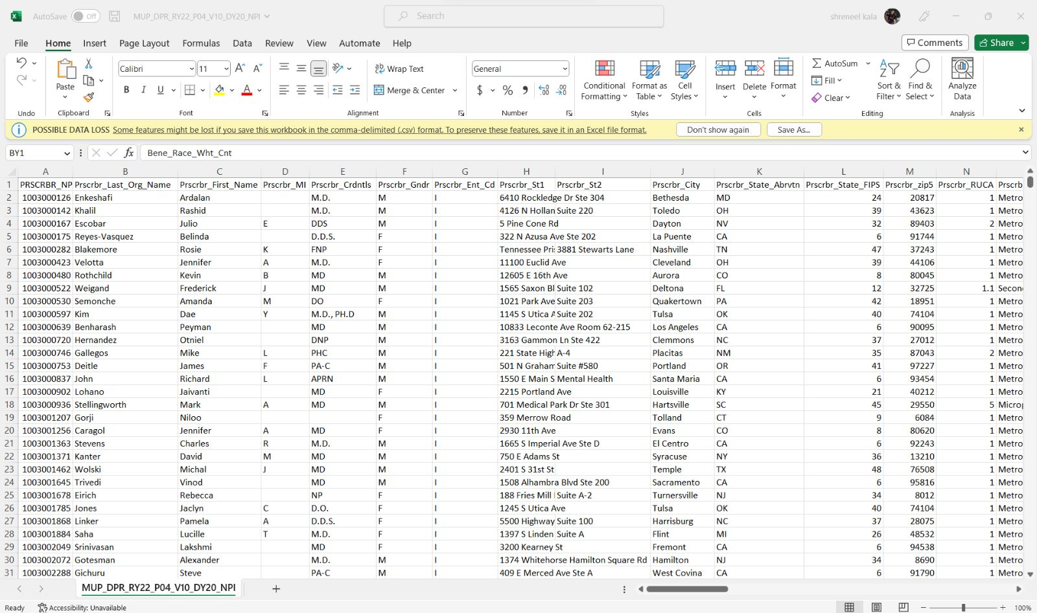
DATASET-1
Medicare Part D Prescribers by Provider dataset
Rows-2,52,09,130
Columns- 21

Slide 6
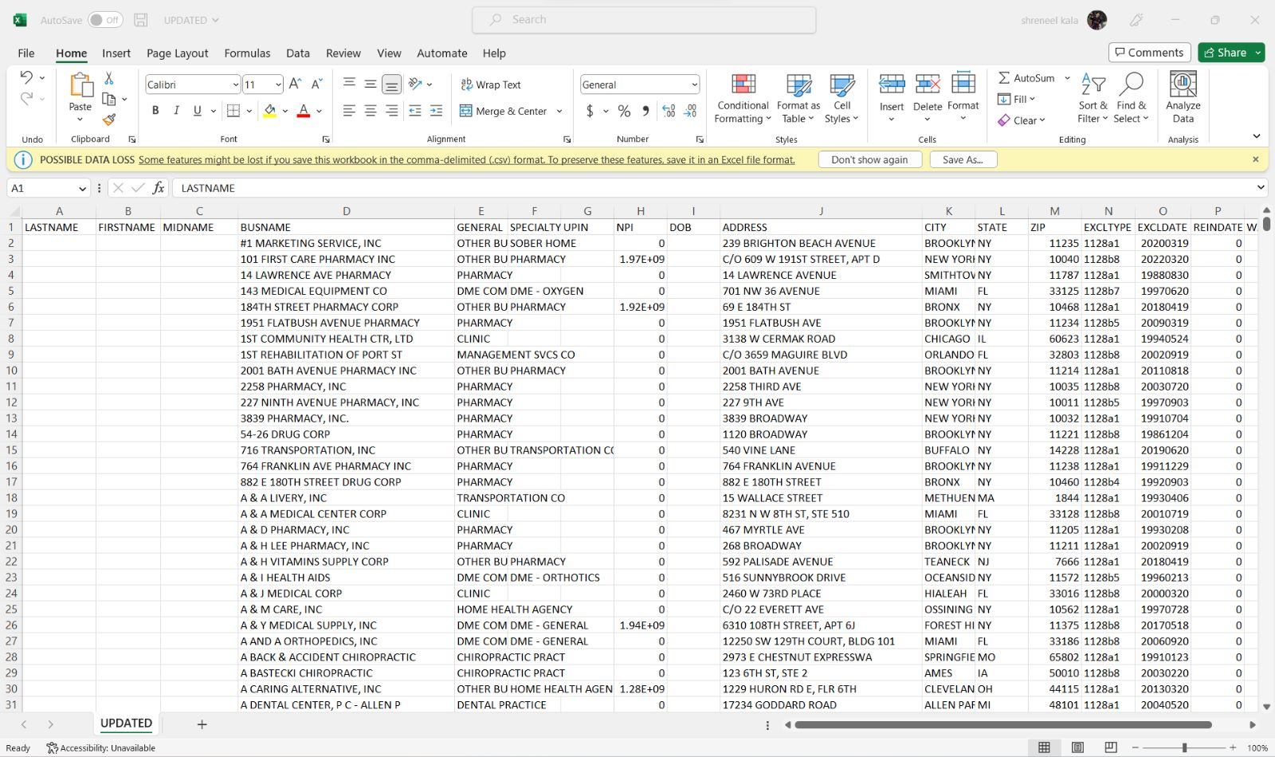
DATASET-2
LEIE Dataset -
This database contains a rundown of people and substances that are prohibited from taking an interest in governmentally financed social insurance programs (for example Medicare) because of past medicinal services extortion. NPI will be used to check payments in comparison to other two datasets.
Rows-9,18,012
Columns-17

Slide 7
DATASET-3
Open Payment Datasets
Each record includes the physician’s demographic information, specialties, and license information, as well as a unique identification number (Physician Profile ID) that can be used to search for a specific physician in the general, research, and physician ownership files.
Rows-10,93,208
Columns- 5

Slide 8
Feature Selection
'total_drug_cost_sum',
'Total_drug_cost_mean',
'Total_Payment_Sum',
'Total_drug_cost_max',
'total_claim_count_sum',
'total_claim_count_mean',
'total_claim_count_max',
'Total_day_supply_sum',
'Total_day_supply_mean',
'total_day_supply_max',
'Claim_max-mean',
'supply_max-mean',
'drug_max-mean'
'Npi',
'last_name',
'Speciality',
'First_name',
'City',
'state'

Slide 9
Pre-Processing Techniques Required
Column Renaming
Removing and replacing Null Values
Merging 3 Datasets
Grouping
Training and testing data
Reduced Sampling for testing Models

Slide 10
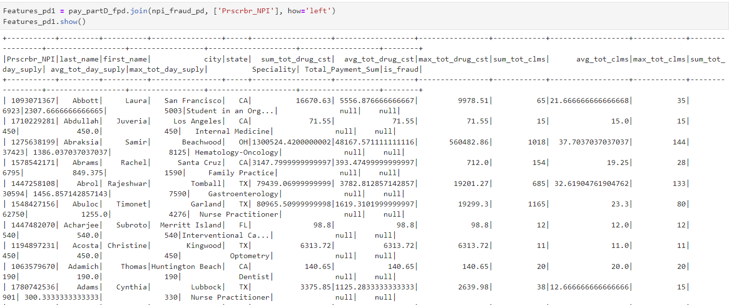
Merging of Datasets

Slide 11
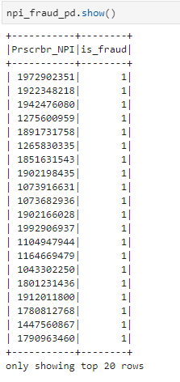
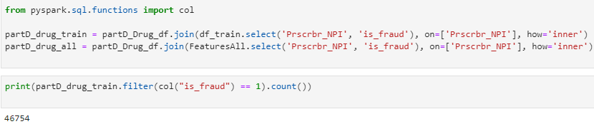
TARGET VARIABLE PROCESSING
Extracting essential columns from from LEIE(List of Excluded Individuals and Entities) database as these contain the information of people who have previous records of insurance frauds
Selecting columns “Prscrbr_NPI” and “EXCLTYPE”
Matching the NPI values to the excluded individuals column to find is_fraud variable
Transforming the “is_fraud” column to binary classification
Joining the is_fraud column to the final dataset
Transforming is_fraud to Binary classification

Slide 12
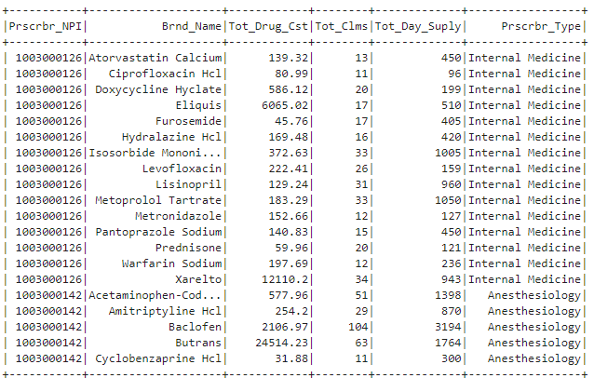
METHODOLOGY
• Data exploration, cleansing and preparation
• Build a simple data model to join all datasets
• Feature engineering to choose the effective feature sets for the different fraud patterns

Slide 13
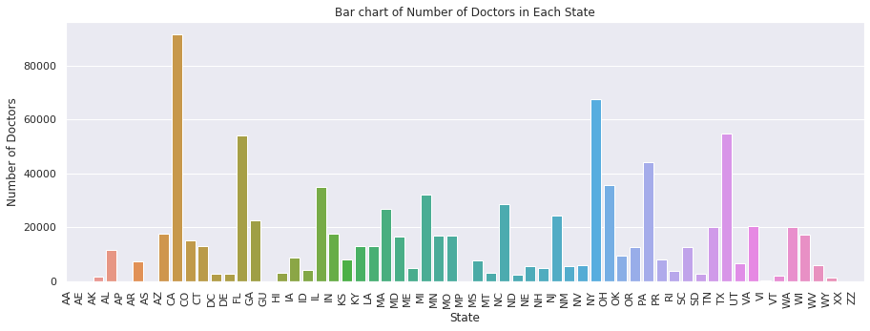
Exploratory DATA Analysis
Fig 1. This graph creates a bar chart representing the number of doctors in each state. We observe that CA, i.e., California has the highest number of doctors.

Slide 14
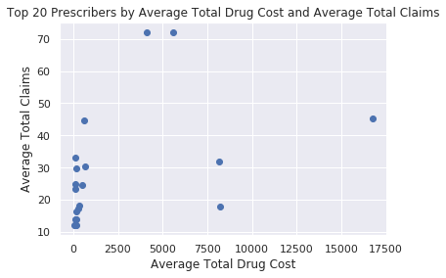
Claims Vs Cost of Drugs
Fig 2. The above graph represents the top 20 Prescribers by Average Total Drug Cost and Average Total Claims. We can infer that the claims are more when the average drug cost is between 0-2500

Slide 15
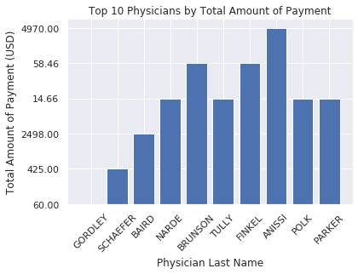
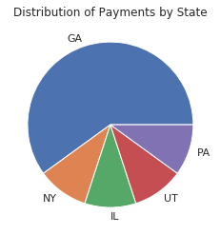
Fig. 3
Fig. 4
Figure 3 represents the the top 10 physicians and the payments made to them. We can see that the most payments were made by Anissi and least by Gordley.
Figure 4 represents the distribution of payments by State where GA has the most amount of total payments

Slide 16
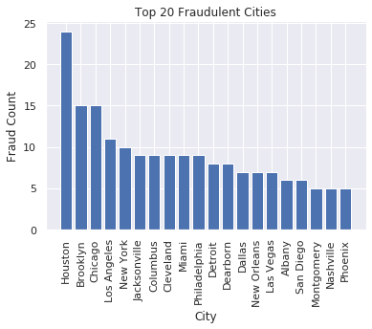
Fraudulent Cities
Fig. 5
This graph demonstrates the number of fraud counts vs the top 20 cities where Houston has the most number of frauds and Phoenix the least.

Slide 17
Vector Assembler And Scaling
We are splitting data into 70% train data and 30% test data for the model
VectorAssembler is a transformer that combines a given list of columns into a single vector column. It is useful for combining raw features and features generated by different feature transformers into a single feature vector, in order to train ML models like logistic regression and decision trees. vecort_assem=VectorAssembler(inputCols=numCols,outputCol="features")
StandardScaler comes into play when the characteristics of the input dataset differ greatly between their ranges, or simply when they are measured in different units of measure. StandardScaler removes the mean and scales the data to the unit variance.
StandardScaler(inputCol='features', outputCol='scaled_feat',withStd=True,withMean=False)

Slide 18
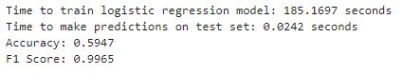
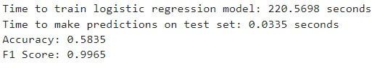
LogisticRegression
4 Nodes
Logistic regression is a classification model used for situations involving binary and linear classification, it is a straightforward and more effective approach.
Logistic regression is an extremely robust and flexible method for binary classification prediction.
These are the hyperparameters:
maxIter: (maximum number of iterations): 100
regParam (regularization parameter): 0.0
elasticNetParam (mixing parameter for ElasticNet regularization): 0.0
2 Nodes

Slide 19
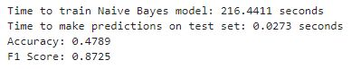
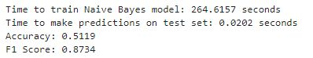
Naive Bayes Classifier
The Naïve Bayes classifier is a supervised machine learning algorithm, which is used for classification tasks, like text classification.
It is also part of a family of generative learning algorithms, meaning that it seeks to model the distribution of inputs of a given class or category.
Here are the some of hyperparameters used:
smoothing=1.0
modelType=’multinomial’
metricName='f1'
4 Nodes
2 Nodes

Slide 20
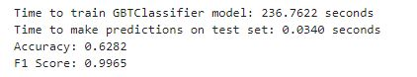
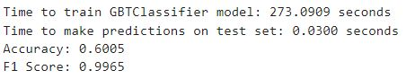
Gradient Boosting Tree Classifier
Gradient boosting classifiers are a group of machine learning algorithms that combine many weak learning models together to create a strong predictive model.
The idea behind "gradient boosting" is to take a weak hypothesis or weak learning algorithm and make a series of tweaks to it that will improve the strength of the hypothesis/learner.
Here are the some of hyperparameters used:
maxDepth: 5
maxBins: 32
minInstancesPerNode: 1
4 Nodes
2 Nodes

Slide 21
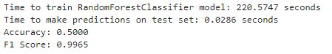
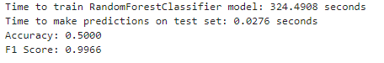
Random Forest Classifier
Random forest is a Supervised Machine Learning Algorithm that is used widely in Classification and Regression problems. It builds decision trees on different samples and takes their majority vote for classification and average in case of regression.
Here are the some of hyperparameters used:
numTrees:20
maxDepth:5
4 Nodes
2 Nodes

Slide 22
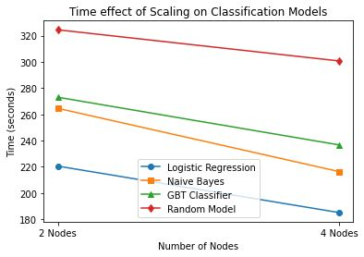
Time Effect of Scaling on Classification Models

Slide 23
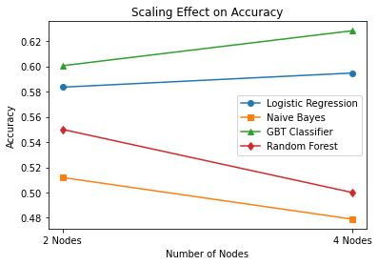
Scaling Effect on Accuracy

Slide 24
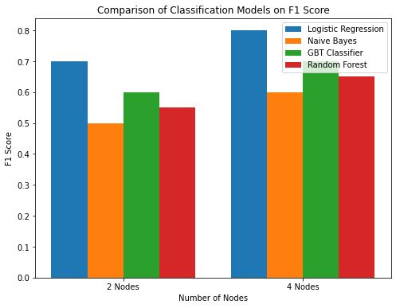
Scaling Effect on F1 Score

Slide 25
Conclusion
Major Outcomes:
This analysis is done on a large dataset which is not balanced.
This cause the accuracy to be low and the F1 Score to be high as the models performs well in minority classes and poorly in majority class
We could identify individuals who were engaging in Medicare insurance fraud
Challenges:
Due to the large dataset the kernel kept dying during the preprocessing and model analysis which compelled us to reduce the data size
Future Scope:
Fraud analysis can be improved if more data related to vendors and prescribers is collected
This method can also be scaled up to be used in real time during the background check of the insurance policy holders

Slide 26
Thank you

